Slide 1
Weather App
Presented
by
Kashish Verma (2210990498)
Nishtha (2210990619)
Nishtha Bansal (2210990620)
Nitya Gautam (2210990626)
Under the supervision
Of
Vikas Patel
Parul Gehlot
Name of Department/School
Chitkara University, Punjab

Slide 2
Introduction
Stepping outside to a surprise downpour or realizing you forgot that extra layer on a chilly morning can put a damper on your day. That's why weather apps have become so popular. But have you ever wondered how they work and where all that information comes from?
This introduction sets the stage by highlighting a common problem (being caught unprepared for the weather) and then positions the weather app as the solution. It also piques the user's curiosity about the inner workings of the app.

Slide 3
Motivation of Research
Improving Accuracy and Forecasting
integrating new data sources like advanced radar systems or satellite imagery.
Tailoring forecasts to specific microclimates within a region
User Experience and Personalization
Developing user interfaces that are more intuitive and visually appealing.
Integrating weather data with other apps (calendars, fitness trackers) for seamless planning
Public Safety and Emergency Management
Developing early warning systems for severe weather events.
Helping users make informed decisions during weather emergencies
Understanding User Behavior and Needs

Slide 4
Tools & Technologies
HTML:Defining the Layout
User Input
Displaying Weather Data
CSS: Defining Style
Formatting Weather Data
Responsiveness and User Experience
JAVASCRIPT: Fetching Weather Data
Updating html content
Using API

Slide 5
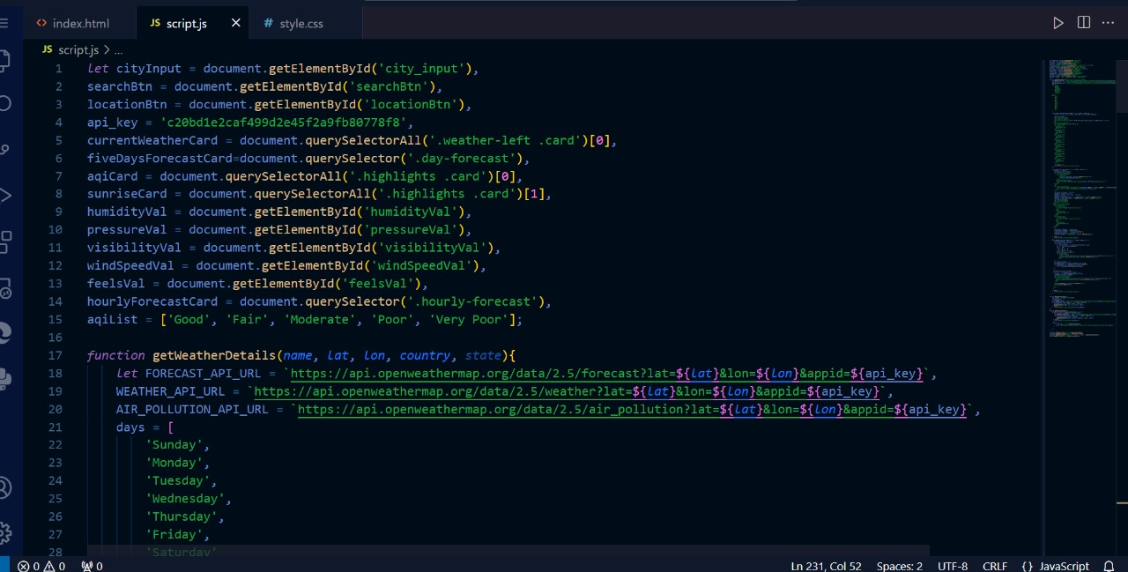
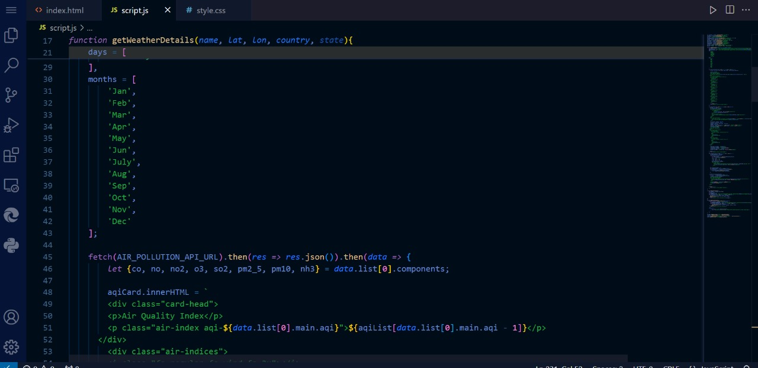
Code Snapshots

Slide 6
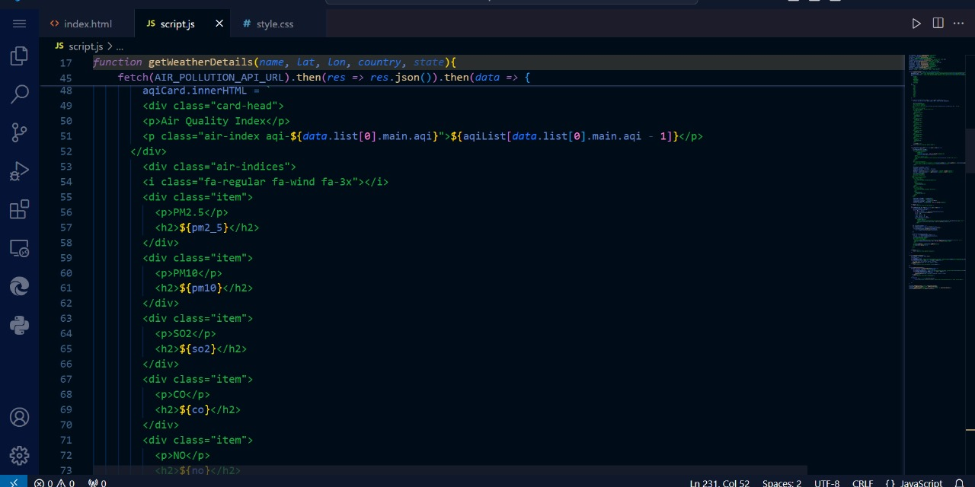
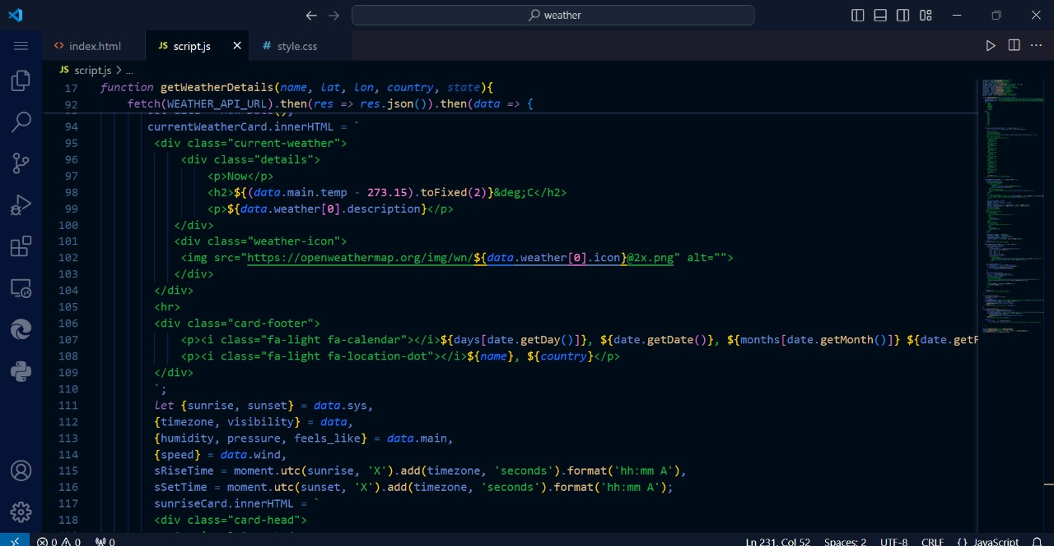

Slide 7
Conclusion/Theme Plan
User benefit
Briefly mention specific features that enhance the user experience (e.g., personalized forecasts, severe weather alerts).
Future development
Implementing advanced features like hyper-local weather or AI-powered recommendations.
Integrating new data sources for even more comprehensive forecasts.
Overall impact
Briefly mention how the app contributes to a broader effort of understanding and potentially mitigating the effects of climate change (through features like historical data analysis or sustainable practice recommendations).
.

Slide 8
References
W3school: https://www.w3schools.com/REACT/react_components.asp
GFG:
https://www.geeksforgeeks.org/react-tutorial/?ref=dhm
Youtube:
https://www.youtube.com/watch?v=GARsvcSdtj8&t=103s
https://www.youtube.com/watch?v=Od5tx5Svae8

Slide 9
Questions???
ANY QUESTIONS????

